Slide 1
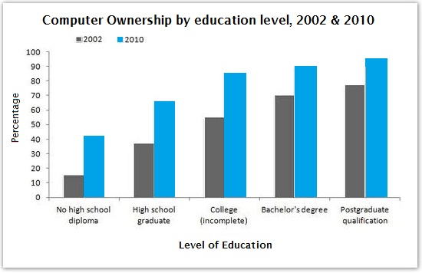
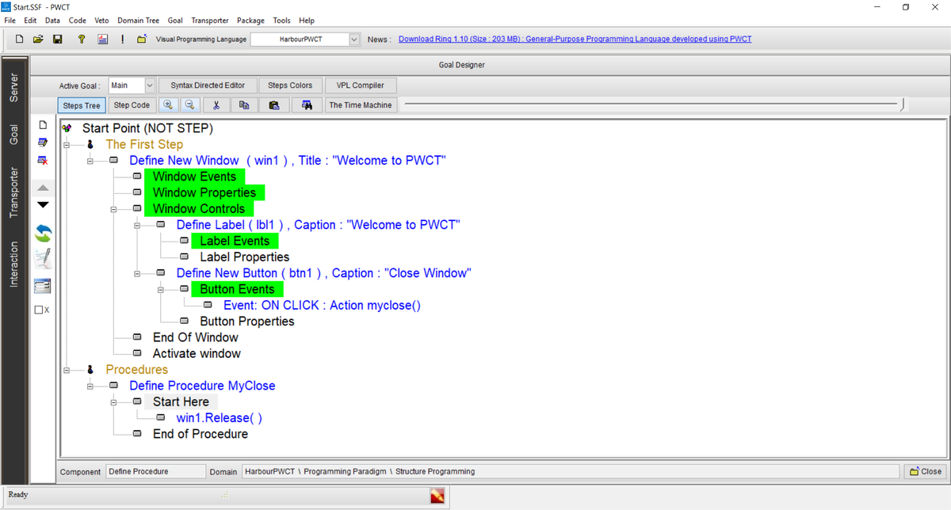
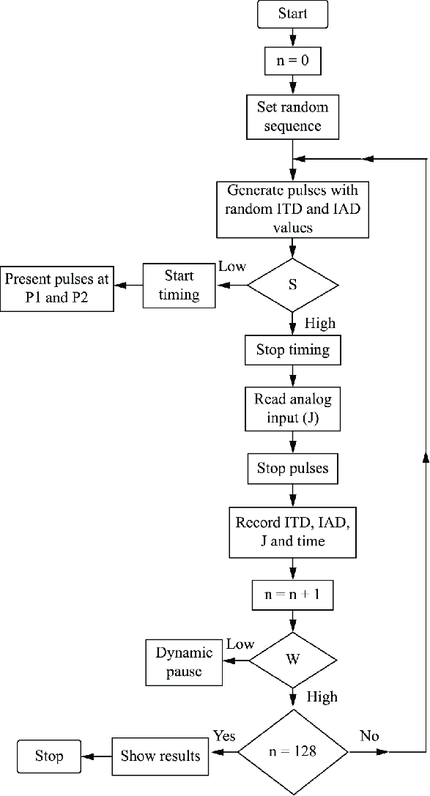
Title First Name Only
Problem or Question Make sure that your font is 13pt or larger! Please state the research problem being addressed. A leading core graphic or visual is encouraged, but not required. | Findings It is advised that this quadrant should primarily be a graphic representation of relevant data and results. Text should be kept to a minimum. This is too much text.
Framework Please provide a succinct, bulleted summary of the methodology/project design. | Interpretation & Conclusions State your conclusion. Remember that all 4 quadrants must be the same size, despite how much information you have. To change the background color in Google slides, click “slide” and then “change background.” Be sure to choose a light color. To change the color of the lines in your chart, click “format” and then “borders and lines” and “border color.”
Project ID #
Captions on your images and graphs can be 9pt font
Use text box to add captions

